Slide 1
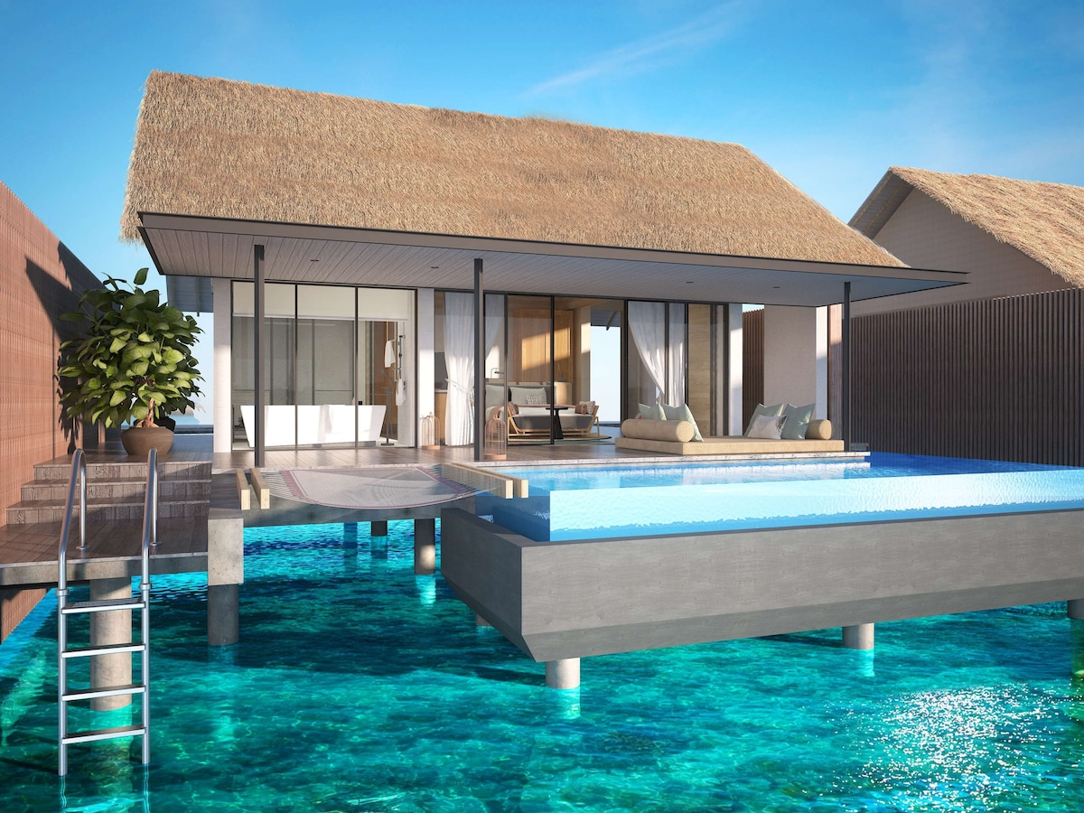
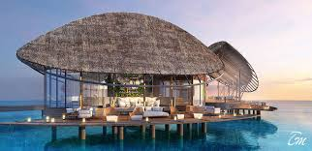
Travel Pack
Prepared for:
Esther Dossa
Crown Towers, Sydney, Australia.
Nov 26th - Nov 30th, 2024

Slide 2
Table of contents
Entry/Exit Information
Etiquette and cultural expectations in Sydney
Event Information
Budget
Itinerary

Slide 3
Entry/Exit
Information

Slide 4
Documentation Requirements
ENTRY
A valid passport or other acceptable travel documents.
Australia Tourist Visa or an Electronic Travel Authority (ETA).
Completed and signed Incoming Passenger Card (IPC).
https://www.abf.gov.au/entering-and-leaving-australia/crossing-the-border/at-the-border/travel-documents#
EXIT
A valid passport
Health and character declaration.
https://travel.state.gov/content/travel/en/international-travel/International-Travel-Country-Information-Pages/Australia.html.

Slide 5
Etiquette and cultural expectations in Sydney.

Slide 6
The Do’s
Arrive on time for gatherings and social events; Sydneysiders value punctuality.
Keep a reasonable physical distance during conversations, as they appreciate personal space.
Use informal greetings like “Hello” or “Hi.” A firm handshake is appropriate for business introductions.
Be environmentally conscious—recycle where possible and avoid littering, as Sydneysiders take conservation seriously.

Slide 7
The Don’ts
Avoid using formal titles like “Mr.” or “Mrs.” in casual settings. First-name basis is common, even in professional settings.
Avoid engaging in political or religious discussions, especially with people you do not know well.
Always wait your turn in line—queue jumping is considered rude.
Don’t ask overly personal questions or pry into someone's private life unless they offer it willingly.

Slide 8
Event Information

Slide 9

Glass Animals Tour of Earth

Slide 10
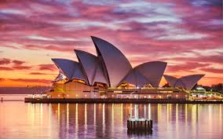
Attend the Sydney Opera house tour (Tour of Earth) hosted by the Grammy-nominated, Platinum-selling British band Glass Animals.
Date: 27th of November, 2024.
Time: Gate opens at 6:30pm

Slide 11
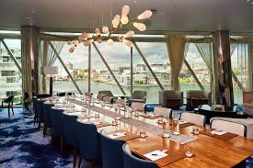
Dinner and Re-union at Crown Towers
A 3-hours dinner and gathering with friend from college.
Date: 28th and 29th of November, 2024.
Time: 6:00 pm daily

Slide 12
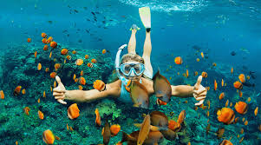
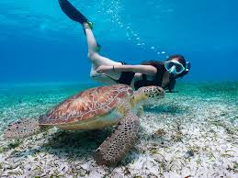
Snorkel and Dive
Date: 28th of November, 2024.
Location: Shelly Beach
Time: 10am to 4pm

Slide 13
Budget

Slide 14
BUDGET | COST ($)
Visa application process | 125
Flights | 500
Accomodation | 1,407
Activities | 1,830
Meals | 1,500
Total cost | 5,362

Slide 15
Itinerary

Slide 16
TRIP ITINERARY
PURPOSE | VACATION |  |  |  | PREPARED FOR | ESTHER DOSSA |  | TRIP START | 26TH NOV 2024
DESTINATION | SYDNEY, AUSTRALIA |  |  |  | PREPARED BY | SELF |  | TRIP END | 30TH NOV 2024
DEPARTING FLIGHT
Date | Depart - Location | Depart - Time | Airline | Confirm # | Flight # | Arrival - Location | Arrival - Time | More Info
26th Nov 2024 | Lagos, Nigeria | 12:00 noon | Qatar Airways | YBIRI7 | QR184 | Kingsford Smith Airport | 11:35 (27th NOV 2024)
RETURNING FLIGHT
Date | Depart - Location | Depart - Time | Airline | Confirm # | Flight # | Arrival - Location | Arrival - Time | More Info
1st Dec 2024 | Kingsford Smith Airport | 00:00 | Qatar Airways | X7Y8Z9 | QR2215 | MMIA, Lagos, Nigeria | 23:35 | Pick up by Driver by 23:40

Slide 17
GROUND TRANSPORT AT DESTINATION
Date | Company | Type of Transport | Meet Up Point | Confirm # | Pick-Up Time | Return Date | Return Time | More Info
27/11/2024 | Europcar | Car rental | Terminal | 14136 | 11:40 | 30th of Nov 2024 | 23:20 | Car model: SUV, Colour: Red
HOTEL
Date | Name | Street | City | Confirm # | Room | Check-In Time | Check-Out Time | More Info
27th of Nov 2024 | Crown Towers Sydney | 1 Barangaroo Avenue | Barangaroo | CTSY123456 | 2807 | 12:00 | 11:59 (30th Nov 2024) | Ocean view, Gym, Pool

Slide 18
EVENTS
Date | Venue | Street | City | Contact Person | Event | Start Time | End Time | More Info
27th Nov 2024 | Sydney Opera house | Bennelong Point, Sydney | New South Wales | --- | Musical tour by Glass Animals band | 18:30 | 23:30 | Colour code: Beige
28th Nov 2024 | Shelly beach | Shelly Beach Road | Manly | --- | Snorkel and Dive | 10:00 | 16:00 | Outfit: Casual
28th & 29th Nov 2024 | Crown Towers | 1 Barangaroo Avenue | Barangaroo | Friends | Re-union and Dinner | 18:00 | 21:00 | Outfit: Maxi Dress

